Slide 1
Hate Comment Prediction
EDA

Slide 2
Problem Statement
Our goal is to build a prototype of online hate and abuse comment classifier which can used to classify hate and offensive comments so that it can be controlled and restricted from spreading hatred and cyberbullying.
Hate comments are divided into 6 categories which are:
Malignant: It is the Label column, which includes values 0 and 1, denoting if the comment is malignant or not.
Highly Malignant: It denotes comments that are highly malignant and hurtful.
Rude: It denotes comments that are very rude and offensive.
Threat: It contains indication of the comments that are giving any threat to someone.
Abuse: It is for comments that are abusive in nature.
Loathe: It describes the comments which are hateful and loathing in nature.
Model will help in predicting the category of the comment and the platform can take the action accordingly.

Slide 3
Dataset Overview
We have train and test datasets with about 157000 and 153000 rows respectively
8 Columns, following are the datatypes: int64(6), object(2)
The data has Comment ID , Comment Text and 6 Categories
Following problem is a Multi class classification problem with six categorical variables Malignant, Highly malignant, Rude, Threat, Abuse, Loathe which are denoted by ‘1’ and the clean comments are denoted by ‘0’.
The Comment in the data set contain noise which is removed by various cleaning techniques and Lemmatization is applied

Slide 4
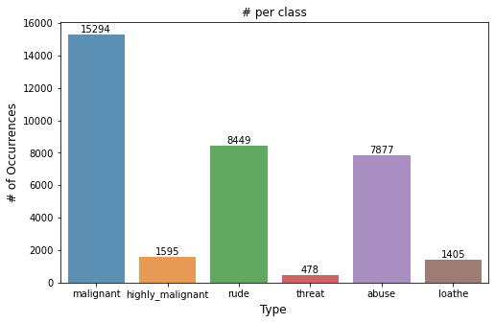
Distribution of the data
The data includes train and test data set which has 159274 and 153000 rows respectively where the train data has
Total comments = 159274
Total clean comments = 143084
Total Hate Comments = 16193
Total tags = 35027
Total number of Words = 158647 words
Maximum length of the sentence = 1250 words
The data has been collected from various social media platforms.

Slide 5
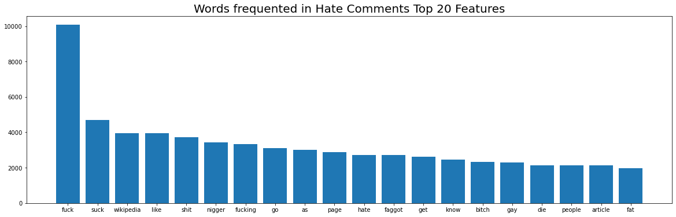
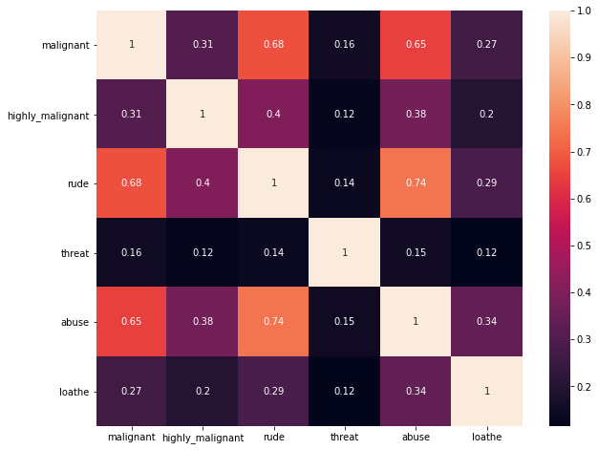
Word Frequency in Hate Comments and Correlation

Slide 6
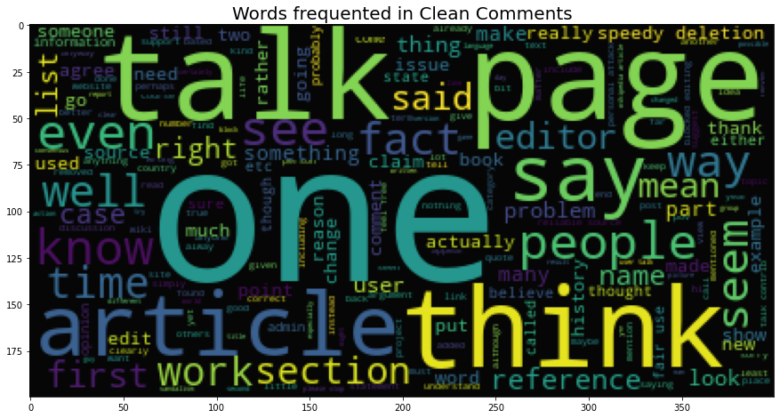
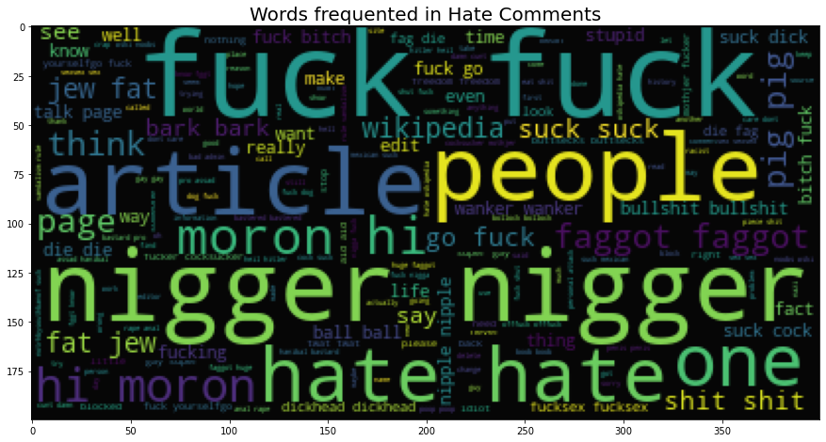
Frequency Word Cloud – Clean and Hate Comments

Slide 7
Assumption Made :
Following assumptions are made for the convenience in problem solving
Total number of Words = 158647 words
Maximum Length of the words = 1250
The total number of word and Maximum length of the sentence has been assumed to be 70,000 words and 500 words as the max length.
Threshold value to convert the output has been considered to be 0.5
<0.5 = 0 and >=0.5 = 1
While Cleaning the dataset we removed the comments where there are less than 3 letters

Slide 8
Model building algorithms used
Model | Parameters | Accuracy | Loss | AUC
LSTM | Categorical cross entropy, Rmprop | 99.38% | 0.3307 | 0.5031
Bidirectional LSTM | Binary Cross entropy, SDG | 99.40% | 0.1421 | 0.7479
Bidirectional LSTM GoldalMaxPool1D | Binary Cross entropy, Adam | 99.41% | 0.0498 | 0.9798
OnevsRest Logistic Regressor | solver= sag | 97.84% | ---- | 0.6613
XGB Classifier | use_label_encoder=False, eval_metric=logloss,objective =binary:logistic | 98.05% | --- | 0.7077
Final Model Scores
Model | Parameters | Accuracy | Loss | AUC | Precision | Recall
Bidirectional LSTM GoldalMaxPool1D | Binary cross entropy, Adam | 99.38% | 0.0498 | 97.98% | 79.21% | 67.27%

Slide 9
Key Findings
LSTM worked best with the NLP data where the multi class classification problem to output binary values determining the category.
Adam was the best performing Optimizer
Bidirectional LSTM with GlobalMaxPoll1d achieved the best scores with 70000 tokens and 500 max lengths of words as the inputs.
There is scope of improvement for Recall and Precision

